Slide 1

Icarus Verilog Installation Guide
for Mac OS Users

Slide 2
Contents
Icarus Verilog Installation
GTKwave Installation
Example Code

Slide 3

Icarus Verilog
An implementation of the Verilog hardware description language
Most commonly used in the design and verification of digital circuits at the register-transfer level of abstraction
A hardware description language (HDL) used to model electronic systems

Slide 4

Homebrew
Package Management Application for macOS
Mostly Used for installing Command-Line Tools or System Packages

Slide 5
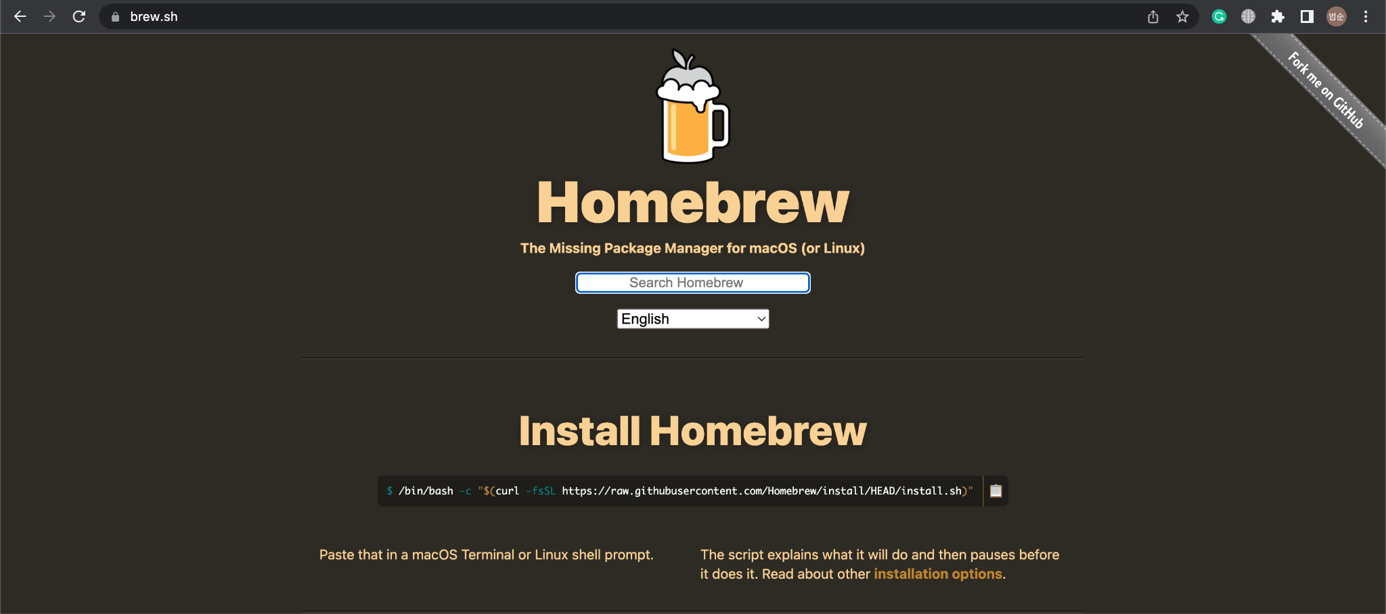
Homebrew Installation - brew.sh

Slide 6
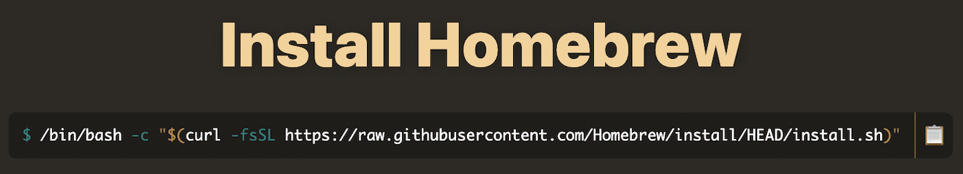
Homebrew Installation
Click Here!
Copy this script (cmd + c / Click the button on the right)

Slide 7
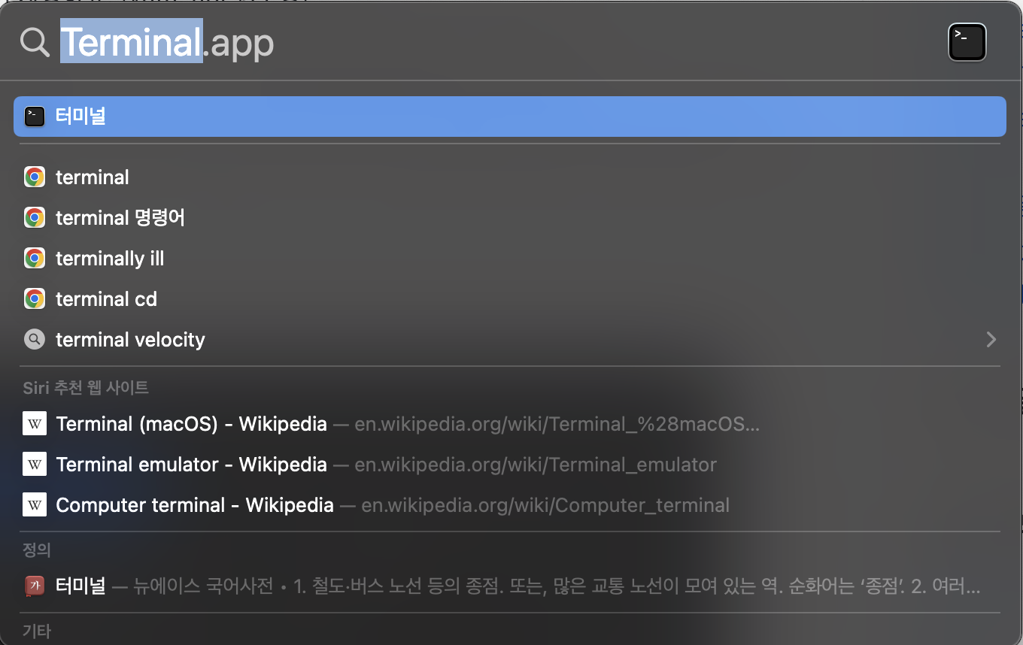
Homebrew Installation
Open your Terminal application

Slide 8
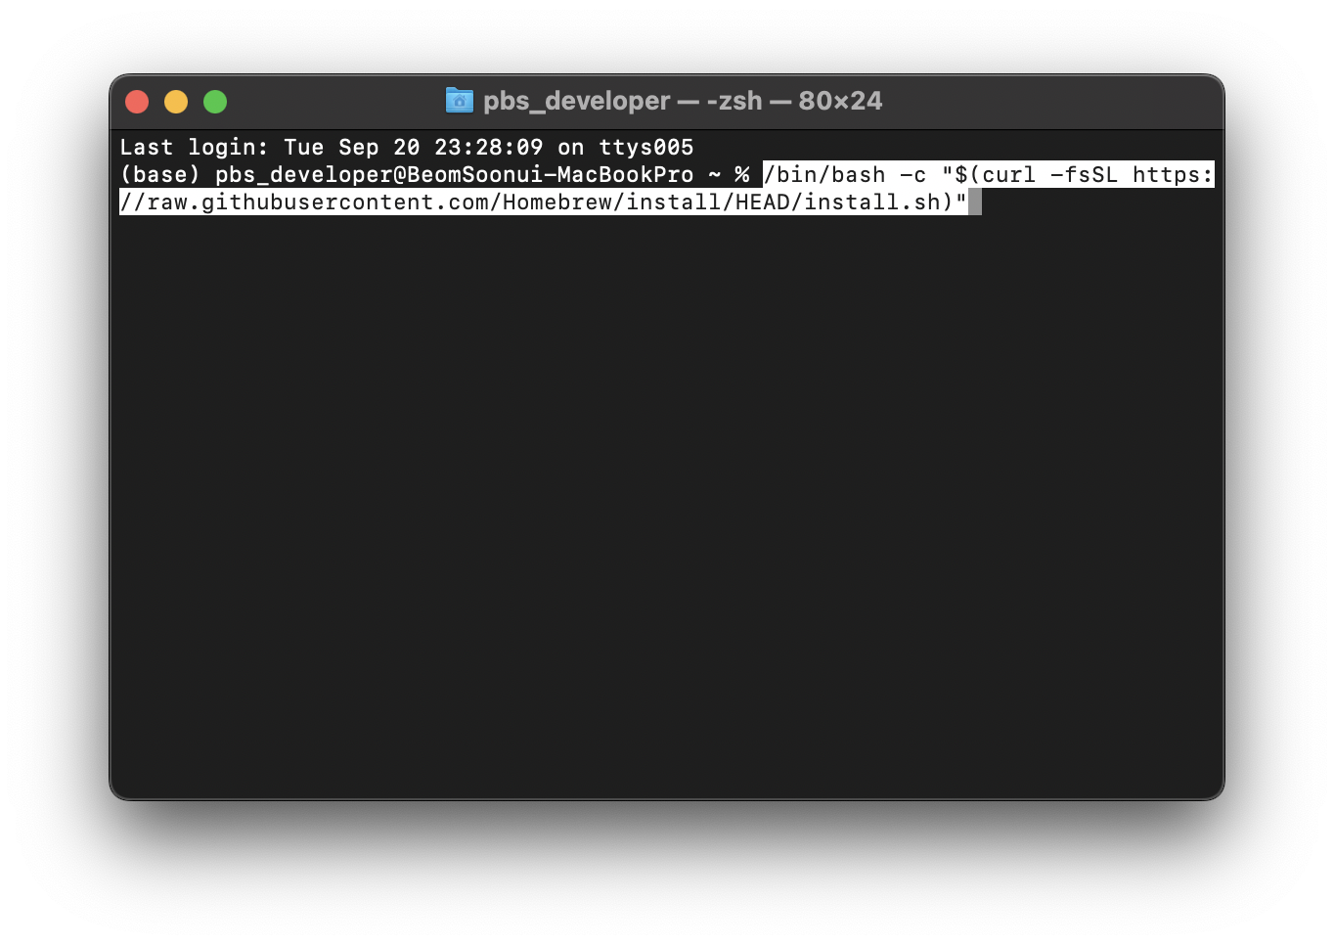
Homebrew Installation
Paste the copied script

Slide 9
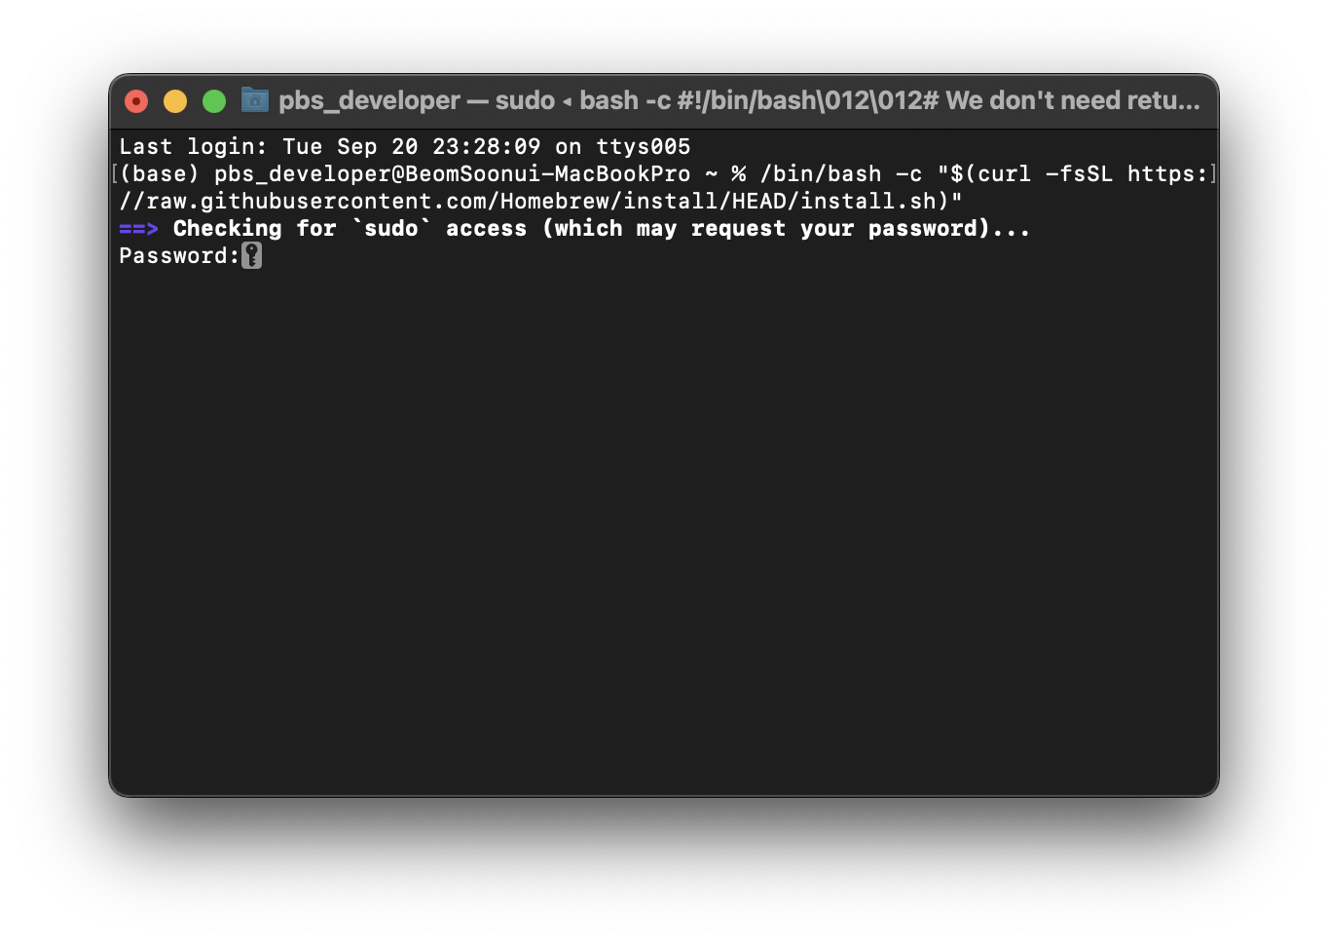
Homebrew Installation
Input your password

Slide 10
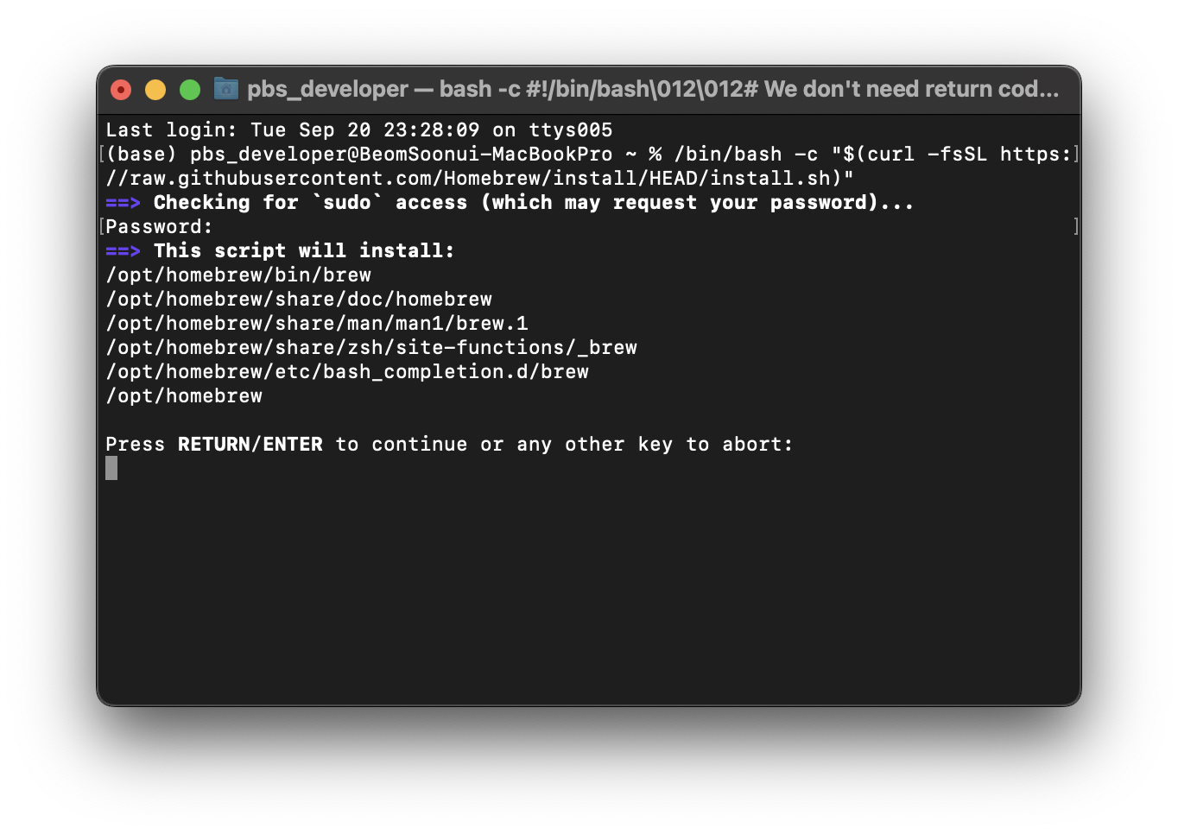
Homebrew Installation
Follow the instruction (Press RETURN/ENTER)

Slide 11
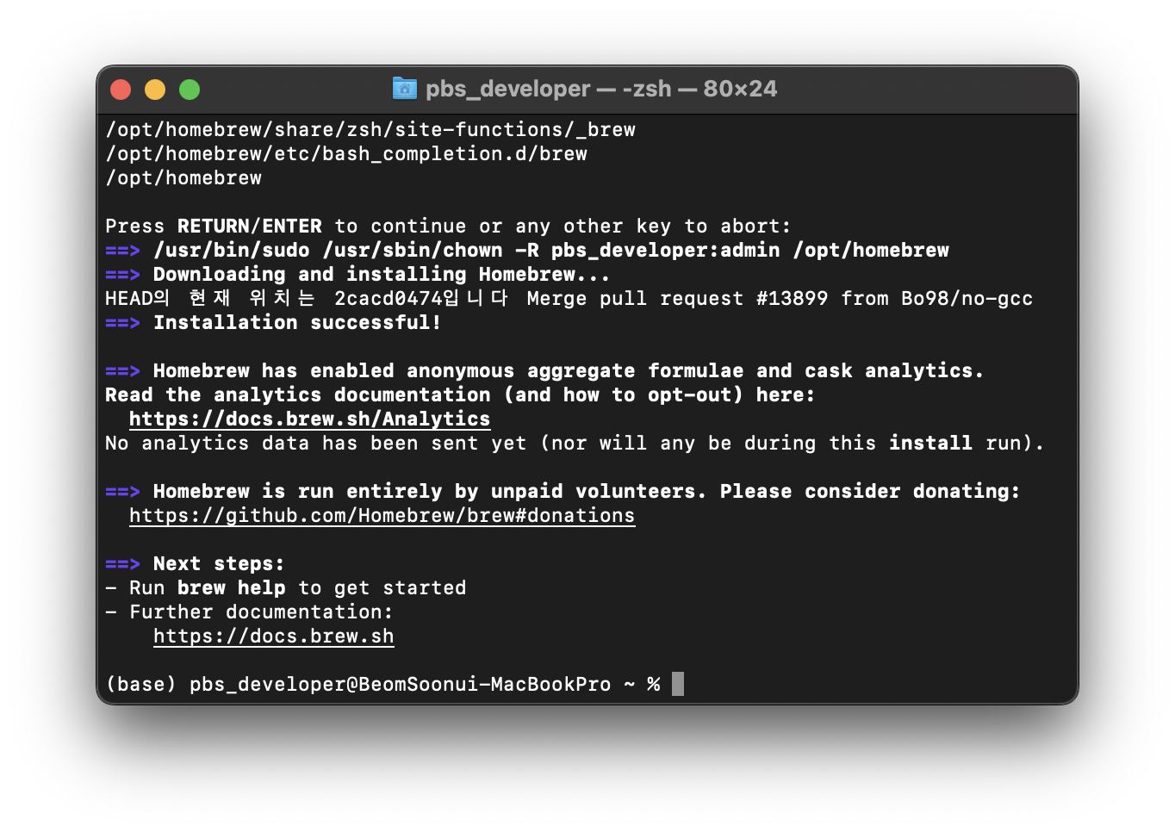
Homebrew Installation
Installation Finished!

Slide 12
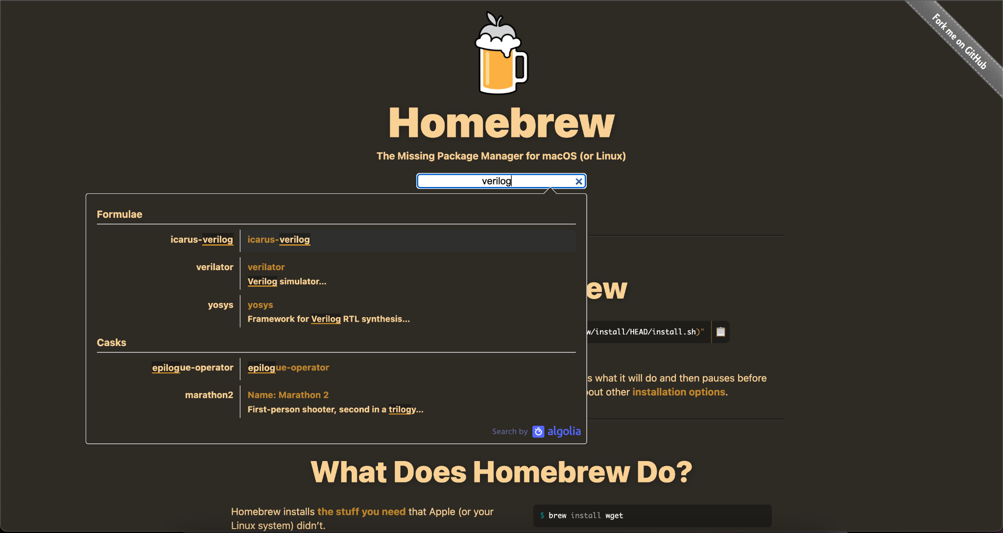
Icarus Verilog Installation
At brew.sh, you can search for the package that you want to install

Slide 13
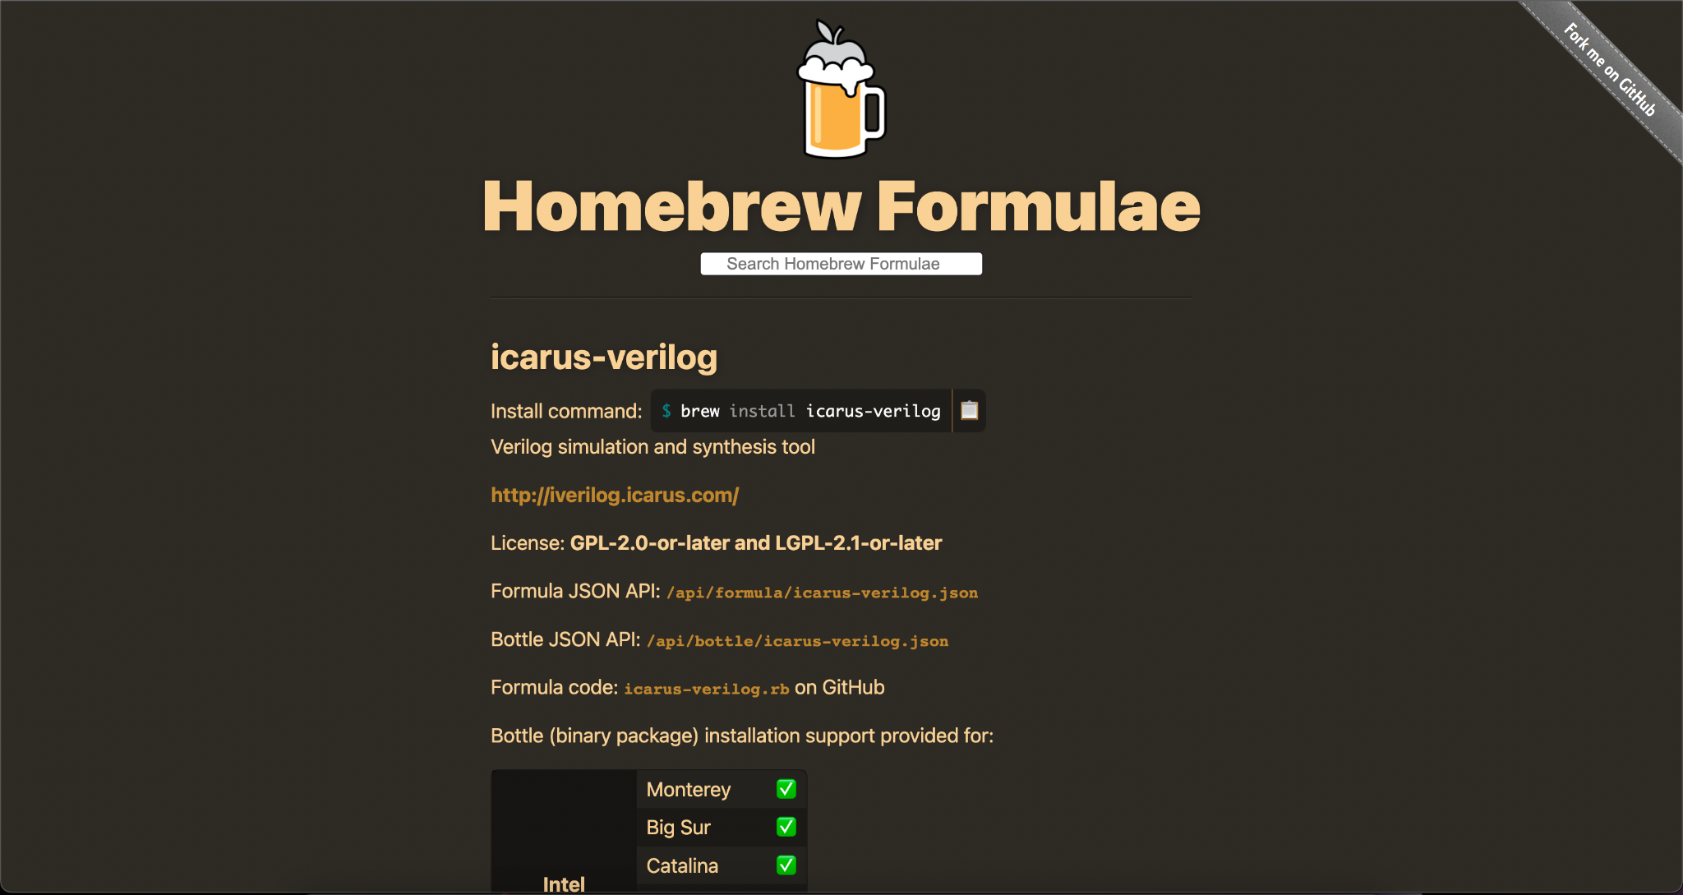
Icarus Verilog Installation

Slide 14
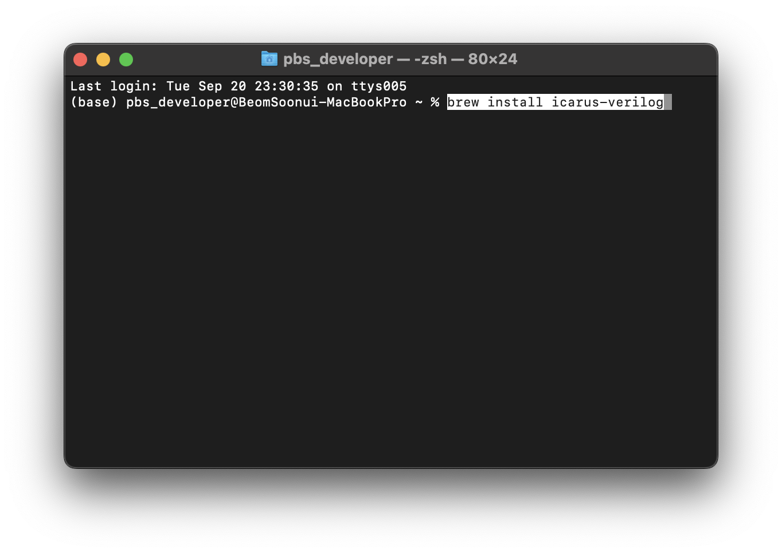
Icarus Verilog Installation
Paste the copied script

Slide 15
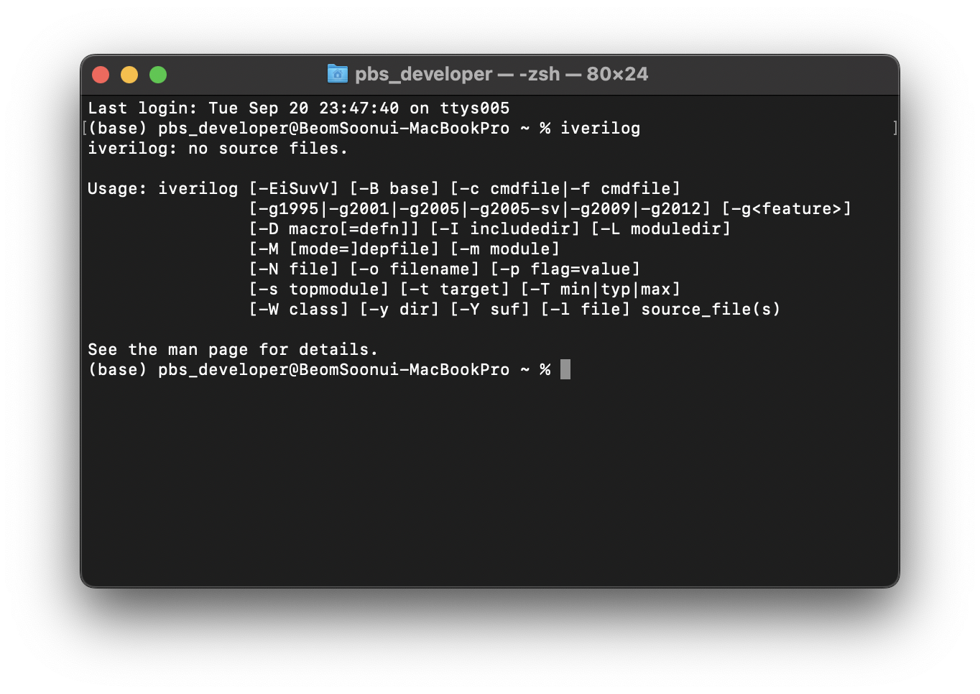
Icarus Verilog Installation
Finished!
Check your installation by typing ‘iverilog’ at the terminal

Slide 16
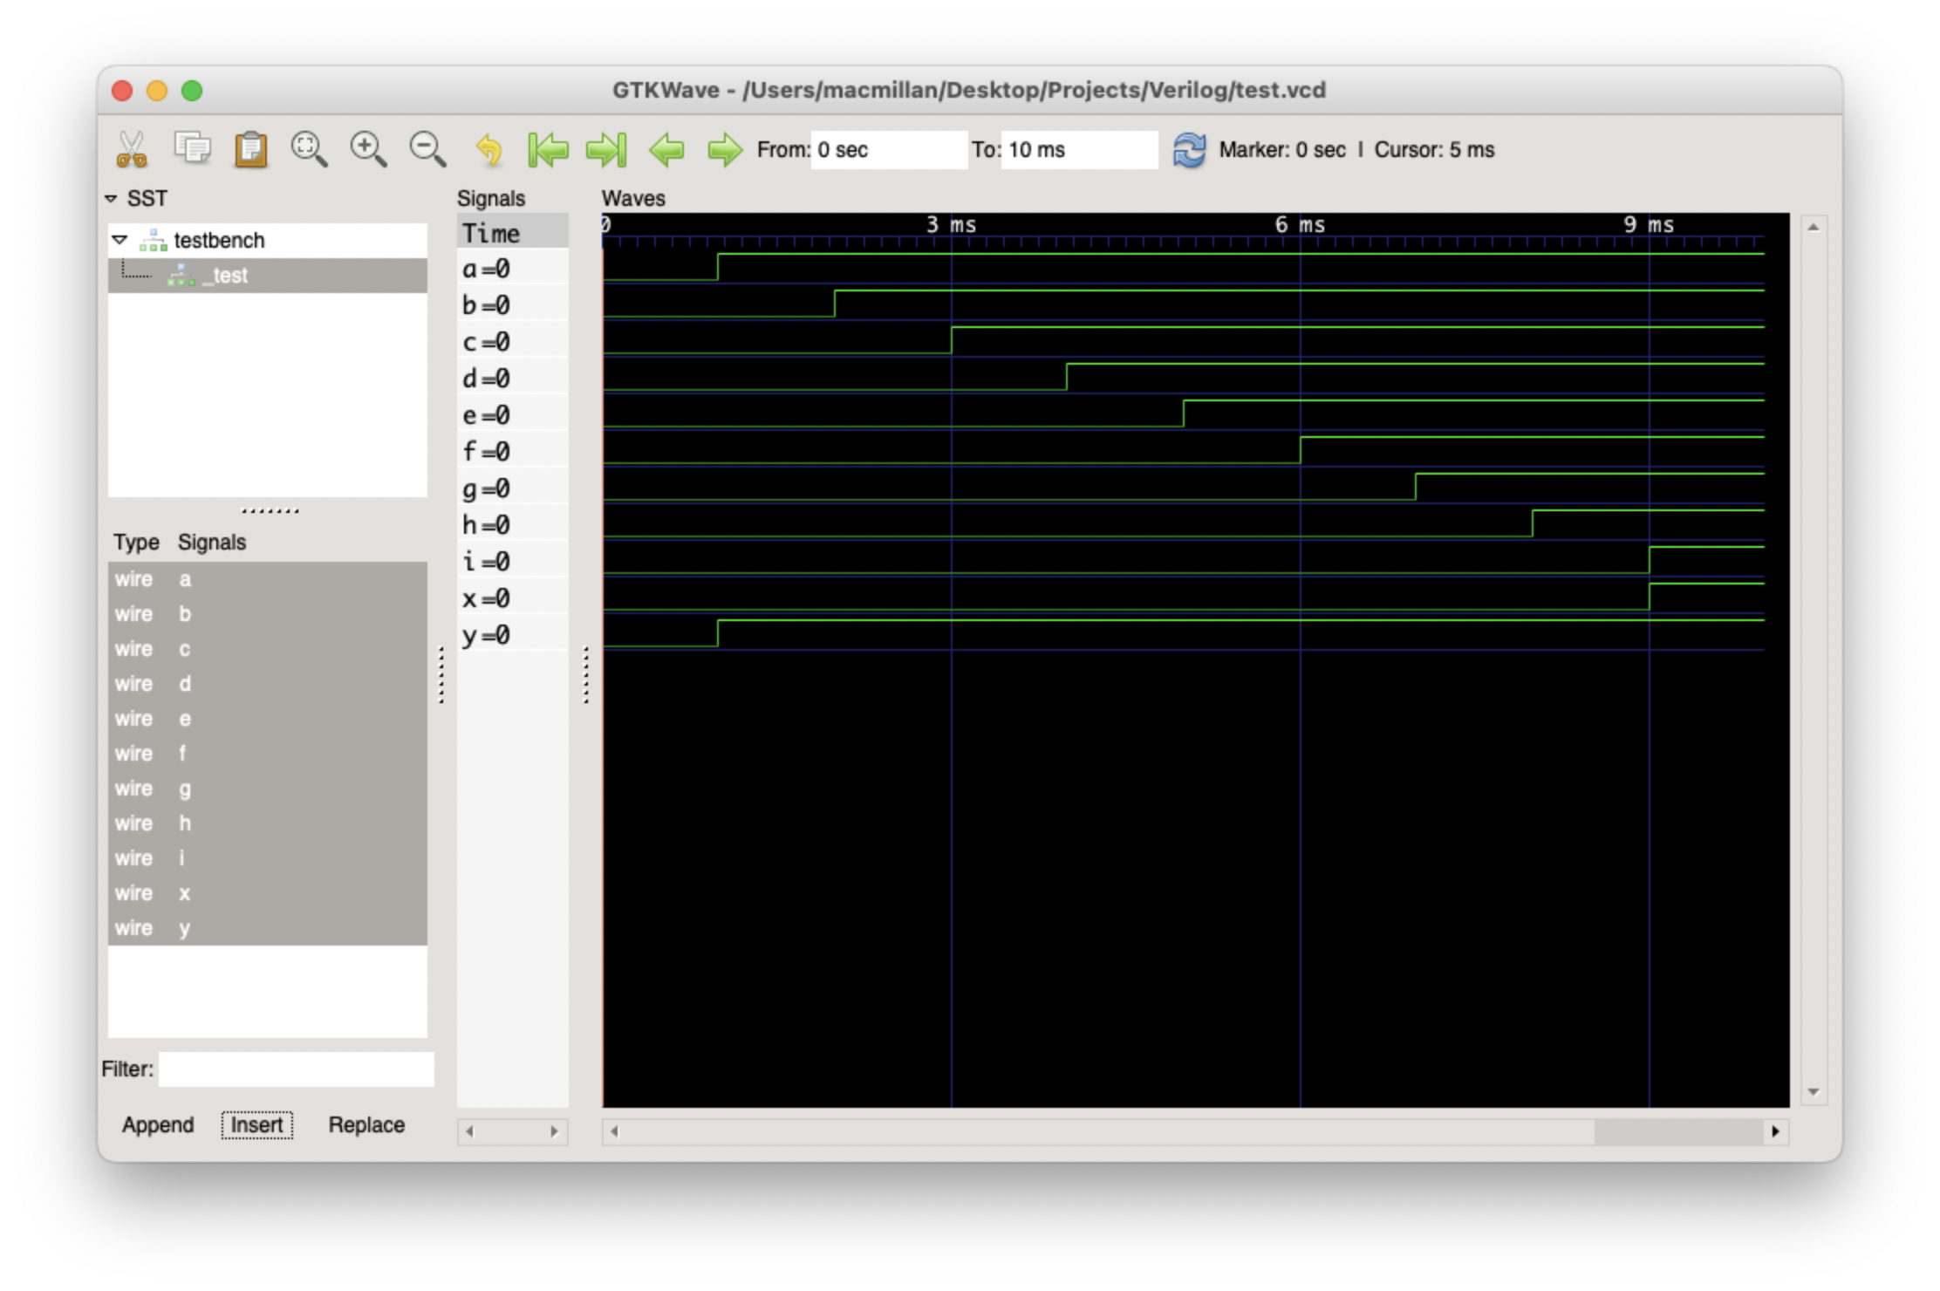
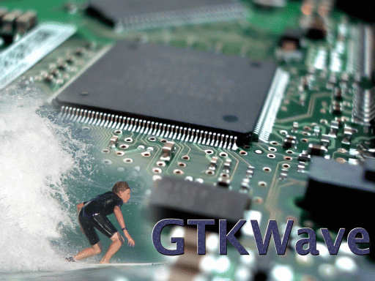
GTKWave
Wave Analyzer for standard Verilog VCD/EVCD files

Slide 17
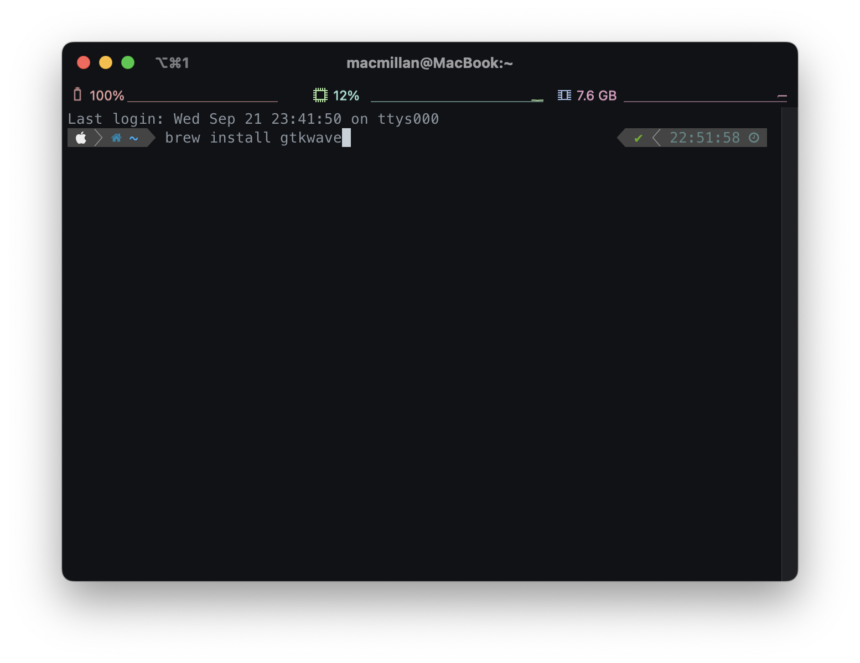
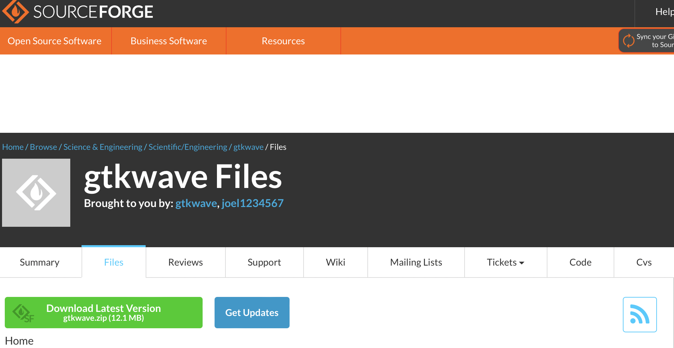
GTKWave Installation
Download file at https://sourceforge.net/projects/gtkwave/files/
or, input command “brew install gtkwave” at terminal

Slide 18
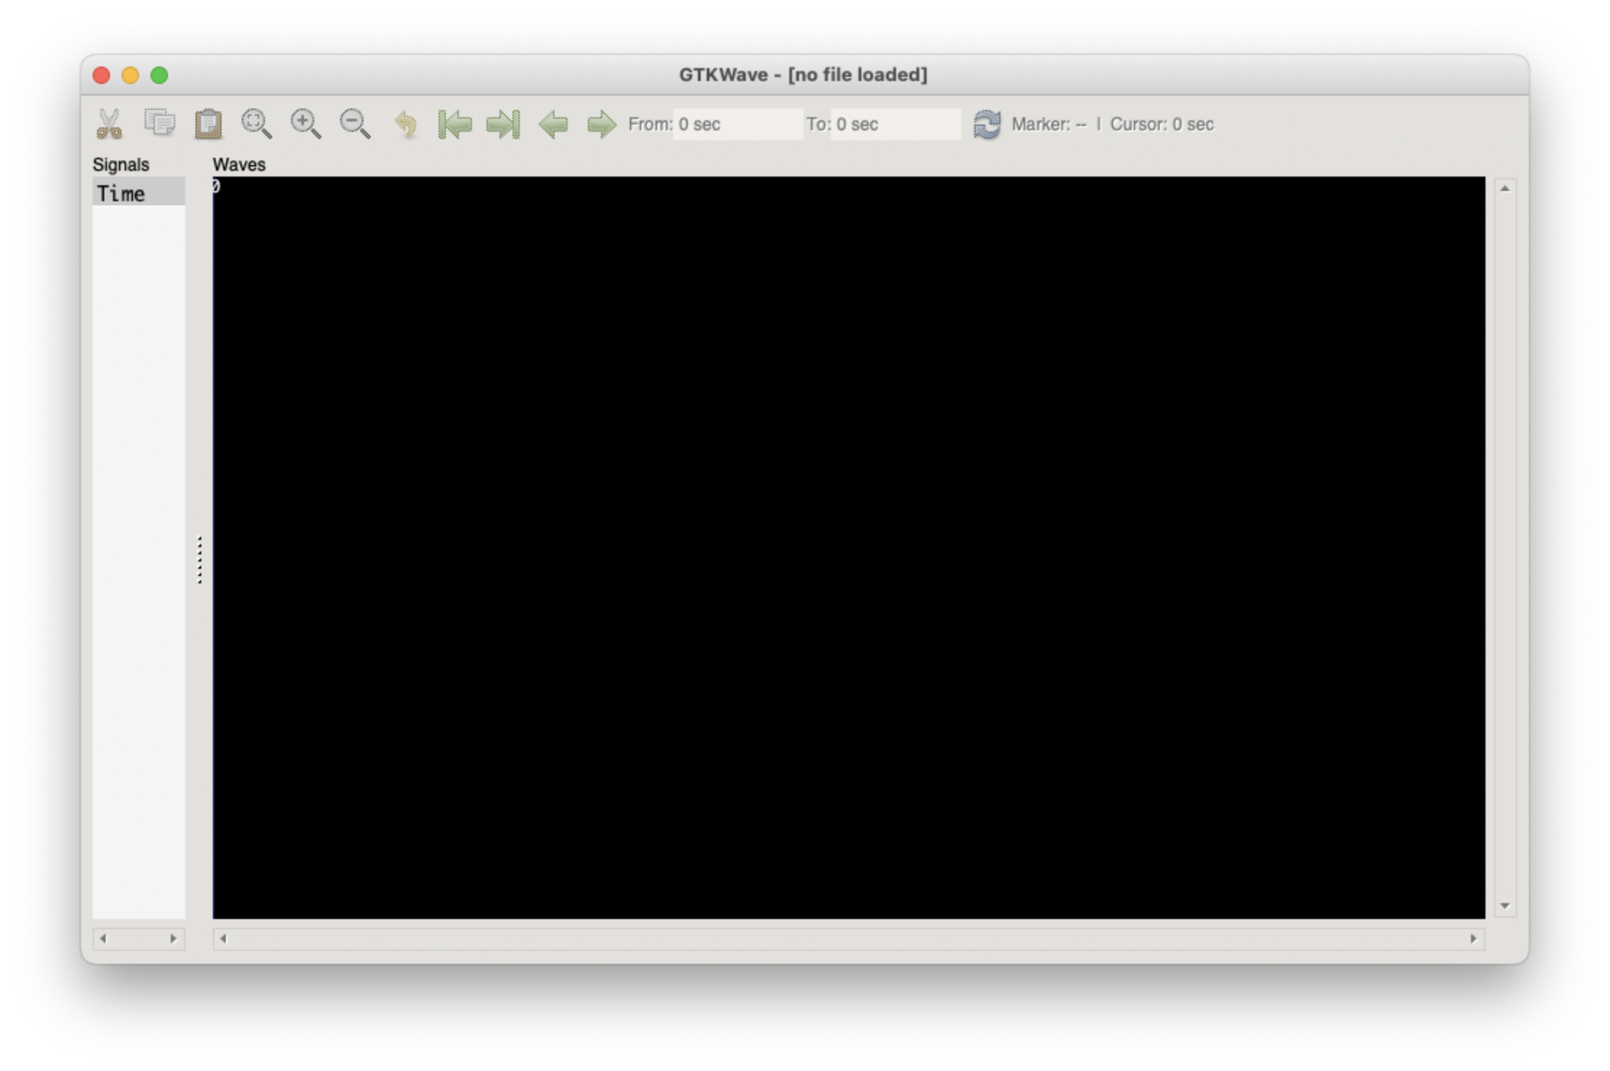
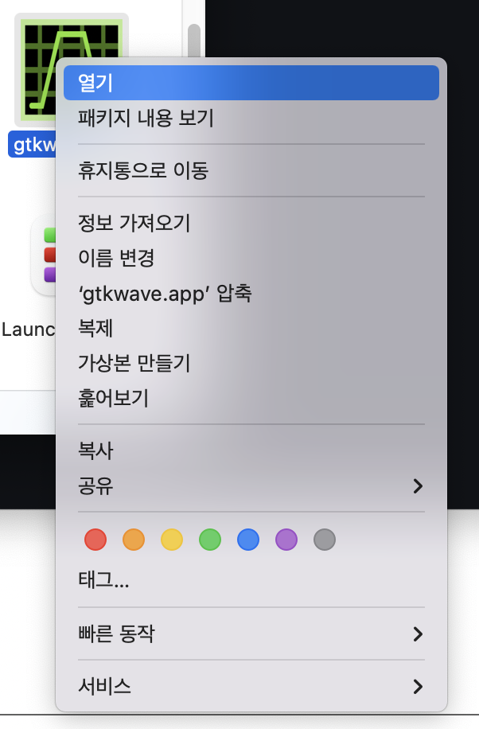
GTKWave Installation
Click the gtkwave.app with RMB and open (to avoid apple’s security warning)

Slide 19
Make Testfiles
By using text editor (like vi, notepad, VSCode etc.)
Make sure filename extension is ‘v’

Slide 20
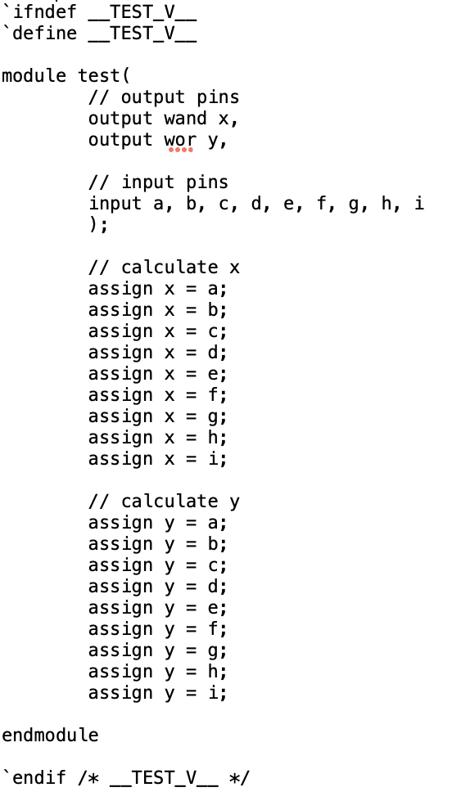
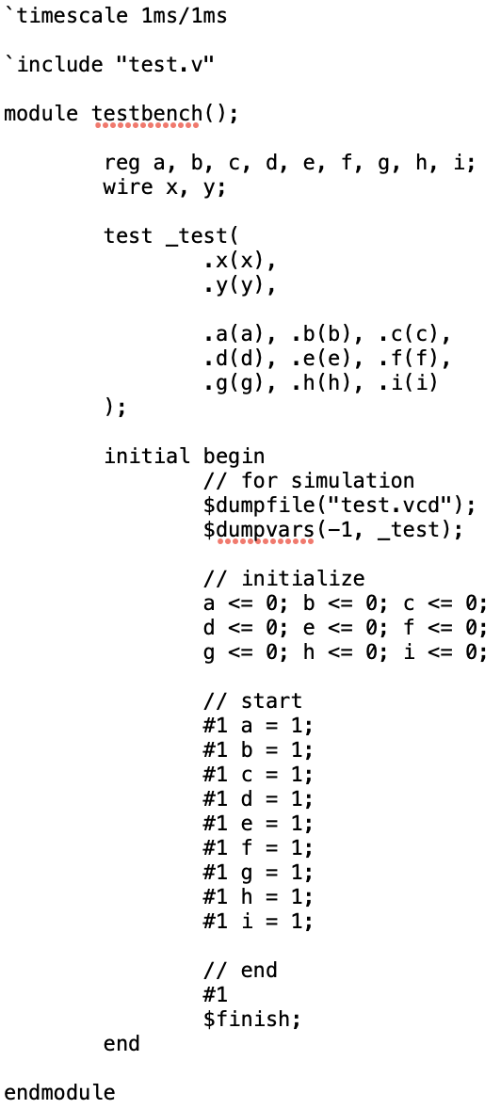
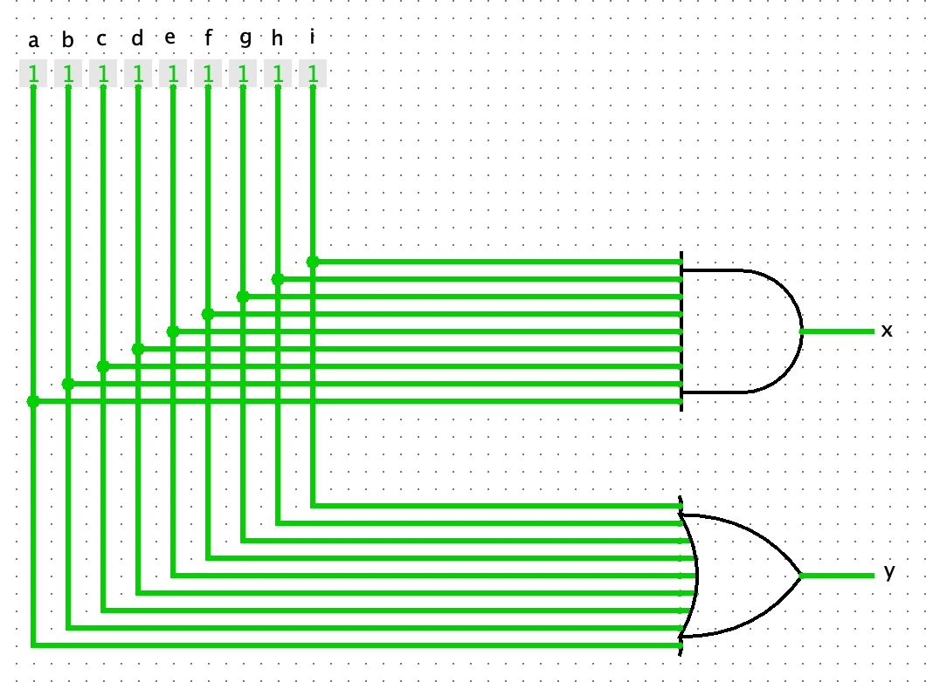
Make Testfiles
test.v
testbench.v

Slide 21
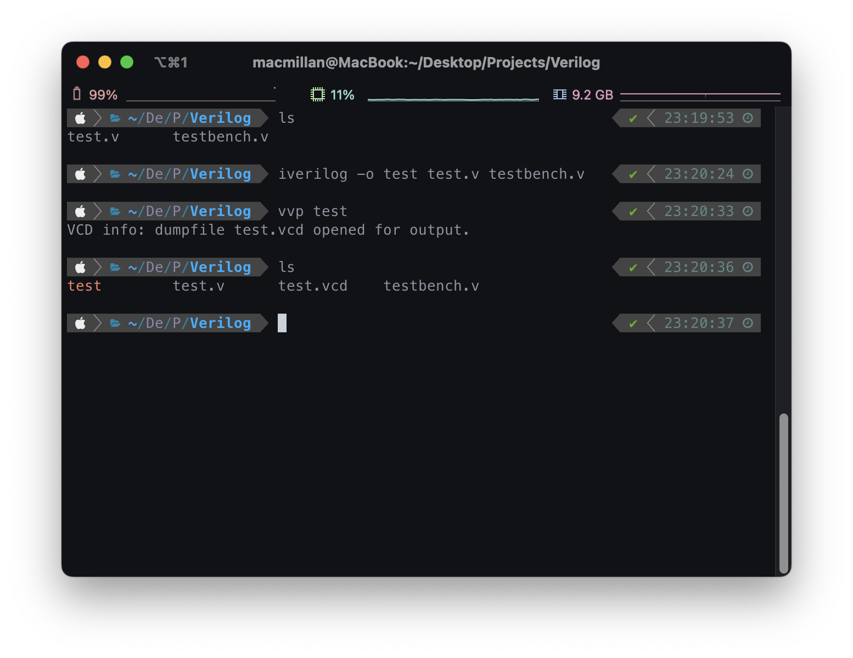
Make Testfiles
Input command “iverilog -o test test.v testbench.v”
Input command “vvp test”

Slide 22
Make Testfiles
Open test.vcd on gtkwave

Slide 23
